Slide 1
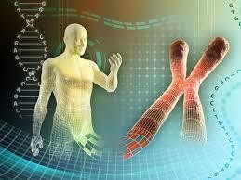

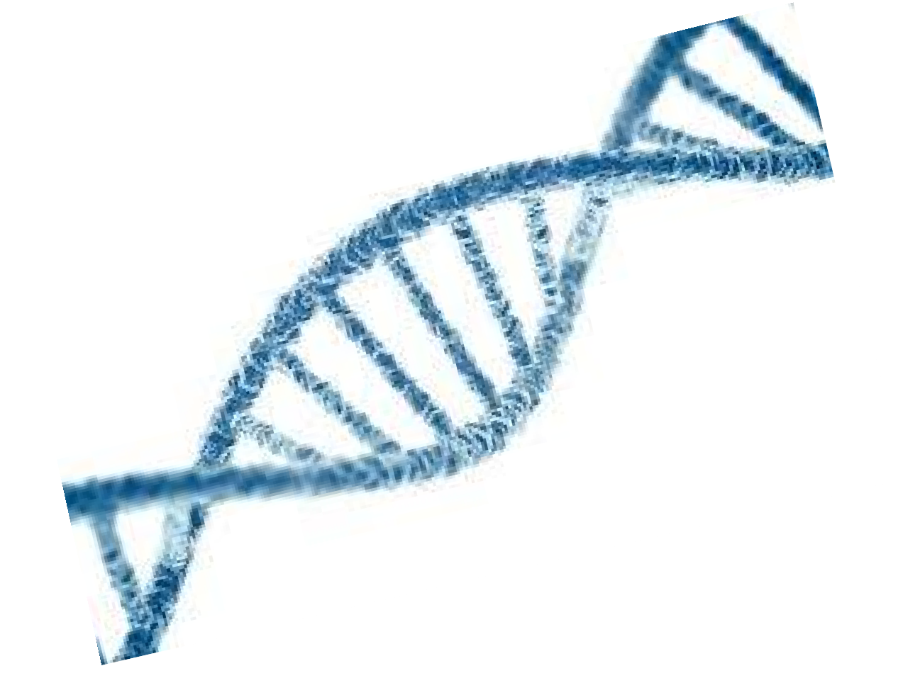
Chapter 5
Human genetics
Pedigree analysis part 1: dominant and recessive

Slide 2
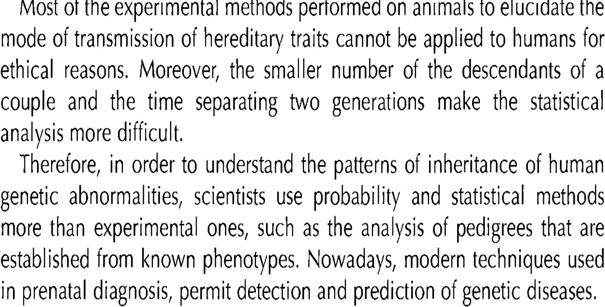

Slide 3
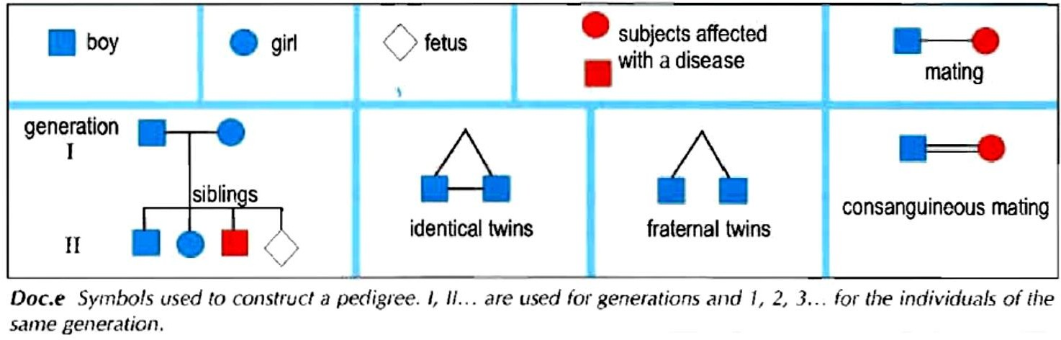

Slide 4



Main characteristics of a hereditary trait to be determined from pedigree analysis
Whether the studied trait is dominant or recessive
Whether the studied gene is located on an autosome or the sex chromosomes
The probability (or risk) of having offspring with a particular trait (or hereditary disease).

Slide 5
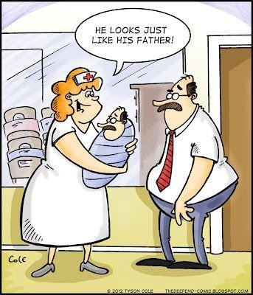
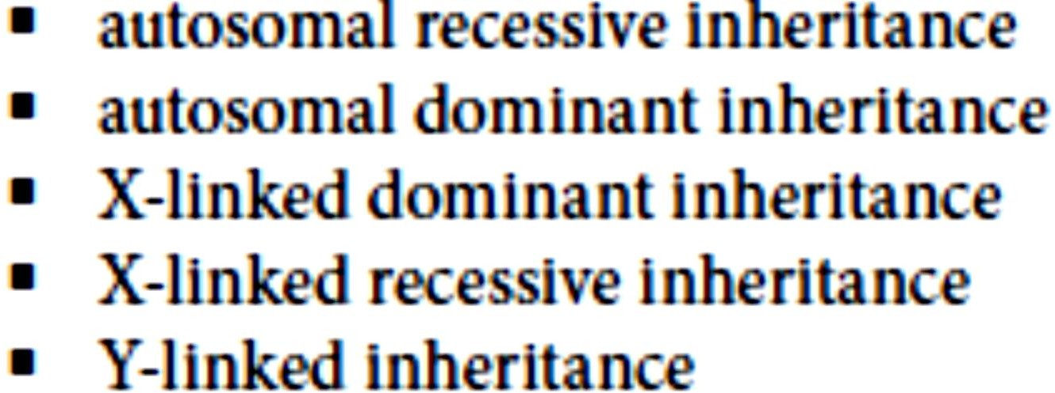
There are five basic patterns of Mendelian inheritance.

Slide 6
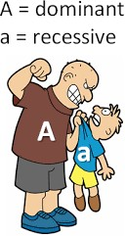
Part 1: determine whether a certain trait is
inherited in a dominant or a recessive manner

Slide 7

Example 1:
In this example we are going to study the transmission of the disease A in a family. To be affected, every individual must possess 2 affected alleles.
The allele of the disease is only expressed when found in 2 copies, thus if it were present with another allele it would be masked; it is recessive.

Slide 8

In this example we are going to study the transmission of the disease B in a family. To be normal an individual should possess two normal alleles.
The allele of the normal phenotype is only expressed when found in 2 copies, thus if it were present with the disease allele it would be masked; it is recessive and the allele of the disease is dominant.

Slide 9

In this example we are going to study the transmission of the disease C. One affected allele isn’t sufficient to express the abnormal phenotype.
One disease allele is not enough to induce the abnormal phenotype, hence two copies are needed for expression and it is a recessive allele.

Slide 10

In this example we are going to study the transmission of the disease D. One affected allele is sufficient to express the abnormal phenotype
One disease allele is enough to induce the abnormal phenotype, hence it can dominate the normal allele; the disease allele is dominant.

Slide 11


In this example we are going to study the transmission of the disease E in the following pedigree:
The disease expressed in daughter 4, but not in her parents. So one or both of the parents carried the allele of the disease and transmitted it to their daughter 4, but it was masked in them; it is recessive.

Slide 12
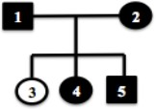

In this example we are going to study the transmission of the disease F in the following pedigree:
The normal allele is expressed in daughter 3, but not in her parents. So one or both of the parents carried the allele of the normal phenotype and transmitted it to their daughter 3, but it was masked in them; it is recessive and it is dominated by the disease allele. (disease dominant)

Slide 13
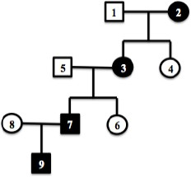

In this example we are going to study the transmission of the disease G in the following pedigree:
The disease allele is expressed in every generation, and every affected individual has an affected parent, so if the disease were recessive, every normal parent would have to be a carrier for the disease, and it is unlikely to have many carriers, so the disease is MOST PROBABLY coded by a dominant allele.

Slide 14

In this example we are going to study the transmission of the disease H in the following pedigree:
3
Couple 5-3 are normal, yet they have an affected son 7, thus the allele of the disease was transmitted from one or both parents, but it was masked in their phenotype, it is recessive.

Slide 15
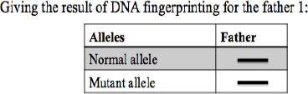

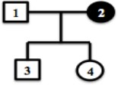
In this example we are going to study the transmission of the disease I in the following pedigree:
The father is normal, yet the DNA analysis shows that he carries both the normal and
disease allele, thus the allele of the disease was masked , it is recessive.

Slide 16

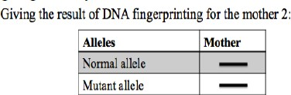

In this example we are going to study the transmission of the disease J in the following pedigree:
The mother is affected with this hereditary anomaly, yet the DNA analysis shows that she carries both the normal and disease allele, thus the allele of the disease was expressed over the normal allele (which was masked) , then the disease allele is dominant.

